Slide 1
AC POWER CONTROLLER WITH PROGRAMMABLE INTERFACE

Slide 2
1
Presented by:
Yash Chandak - 20BAC10026
Aarti Anjar - 20BAC10026
Aniket Verma - 20BAC10042
GUIDED BY : MR.P. NARENDRA BABU

Slide 3
INTRODUCTION:
The project aims at controlling the AC power by using the concept of firing angle control of thyristors . One can enter the required percentage of power supply through a keypad. The input is provided to a microcontroller of 8051 family that initiate the firing angle to adjust the load power. For matching the power to the required one, a TRIAC is used in series with the AC load. A LCD screen is used to display the power percentage that is provided by the user. Based on this input the microcontroller will automatically adjust the power delivered to the lamp through a solid state switching mechanism.

Slide 4
SPECIFICATION
Hardware Specifications
8051 series Microcontroller
Transformer
LCD
Diodes
keypad
TRIAC
Opto Isolator
Lamp
Software Specifications
Keil µVision IDE
MC Programming Language: Embedded C

Slide 5
Microcontroller:-
Full duplex UART serial channel.
8K bytes of in a system programmable.
32 programmable input output lines. 256*8 bit internal RAM.
Keypad:-A keypad is a set of keys placed in a block which frequently bear symbols, digits and a complete set of alphabetical letters.
Opto Coupler:
Opto coupler are made up of a light emitting diode, and package. There is no electrical connection between the two devices. Here, the light responsible device may be a phototransistor, photodiode, or devices like thyristors, TRIAC etc.

Slide 6
TRIAC:- TRIAC, from triode for alternating current, is a generic trademark for a three terminal electronic component that conducts current in either direction when triggered. Its formal name is bidirectional triode thyristor or bilateral triode thyristor.
LCD Display:- In Ac power controller with programmable interface, the LCD display is used for displaying on the keypad through value. It is 16 pins LCD display, interfaced with microcontroller and is powered up with 5 V dc.

Slide 7
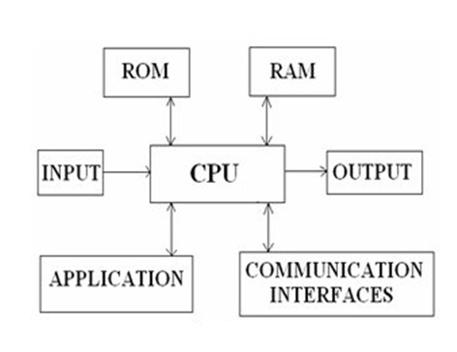
Embedded Systems
An Embedded system can be defined as a blend of hardware and software which jointly form a component of a larger machine. The best example of an embedded system is a microprocessor. An embedded system is intended to run on its own without human interference and may be necessary to react to actions in real time.

Slide 8
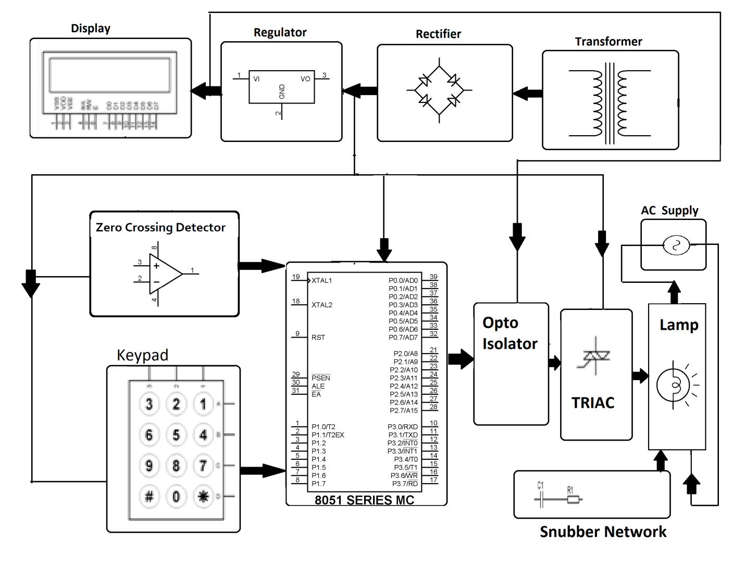
BLOCK DIAGRAM

Slide 9
WORKING:
Project Working
The AC power controller with programmable interference method is used to control the lamp intensity by controlling the AC power to the lamp. This is done by delaying the application of triggering pulses to the TRIAC or using the method of firing angle delay. The zero crossing detector supplies pulses at each zero crossing of the AC waveform which is applied to the Microcontroller.

Slide 10
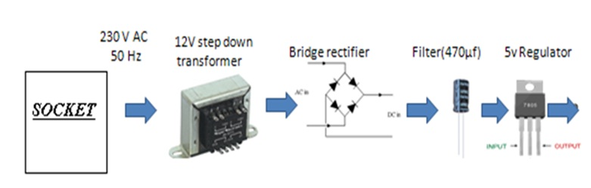
Power Supply:-
The power supply circuit can be built with a step-down transformer, which steps down the voltage from 230V to 12V AC. This AC voltage can be converted to DC using a Bridge Rectifier. The role of the capacitive filter is to remove the ripples and it is then regulated to +5V using a voltage regulator 7805 which is necessary for the process of the microcontroller and other components.

Slide 11

This work is used at controlling the AC power by using the concept of firing angle control of thyristors.
With this device one can enter the required percentage of power supply through a keypad

Slide 12
REFERENCES:-
I. Lee Siang Tat, YiauwKahHaur “AC Power Controller By Using Microcontroller”. ISSN:2180-1843 eISSN:2289-8131.Vol.8 No.12.
II. David Margulies, Clifford E. Felder, Galina Melman and Abraham Shanzer “A Molecular Keypad Lock: A Photochemical Device Capable Of Authorizing Password Entries”. Cite This:J.Am.Chem.Soc.2007,129,2 347-354 Publication date: December 19,2006.https://doi.org/10.1021/ja065317z.
III. Web ProForum Tutorials, “Global System for Mobile Communication (GSM)”, The International Engineering Consortium, http:// www.iec.org.com USA.
IV. Gunnar Heine, “GSM Networks: Protocols, Terminology, and Implementation”, British Library, ISBN:0-89006-471-7, London, 1999.
V. Luis Thayer Ojeda, “Arduino Energy Shield User Manual”, www.olimex.com cl, Santiago, Chile, 2011.
VI. Arduino UNO, www.arduino.com .

Slide 13
Thanks!

